Slide 1
The Bug Slayers
NASA Space App Challenge 2020

Slide 2




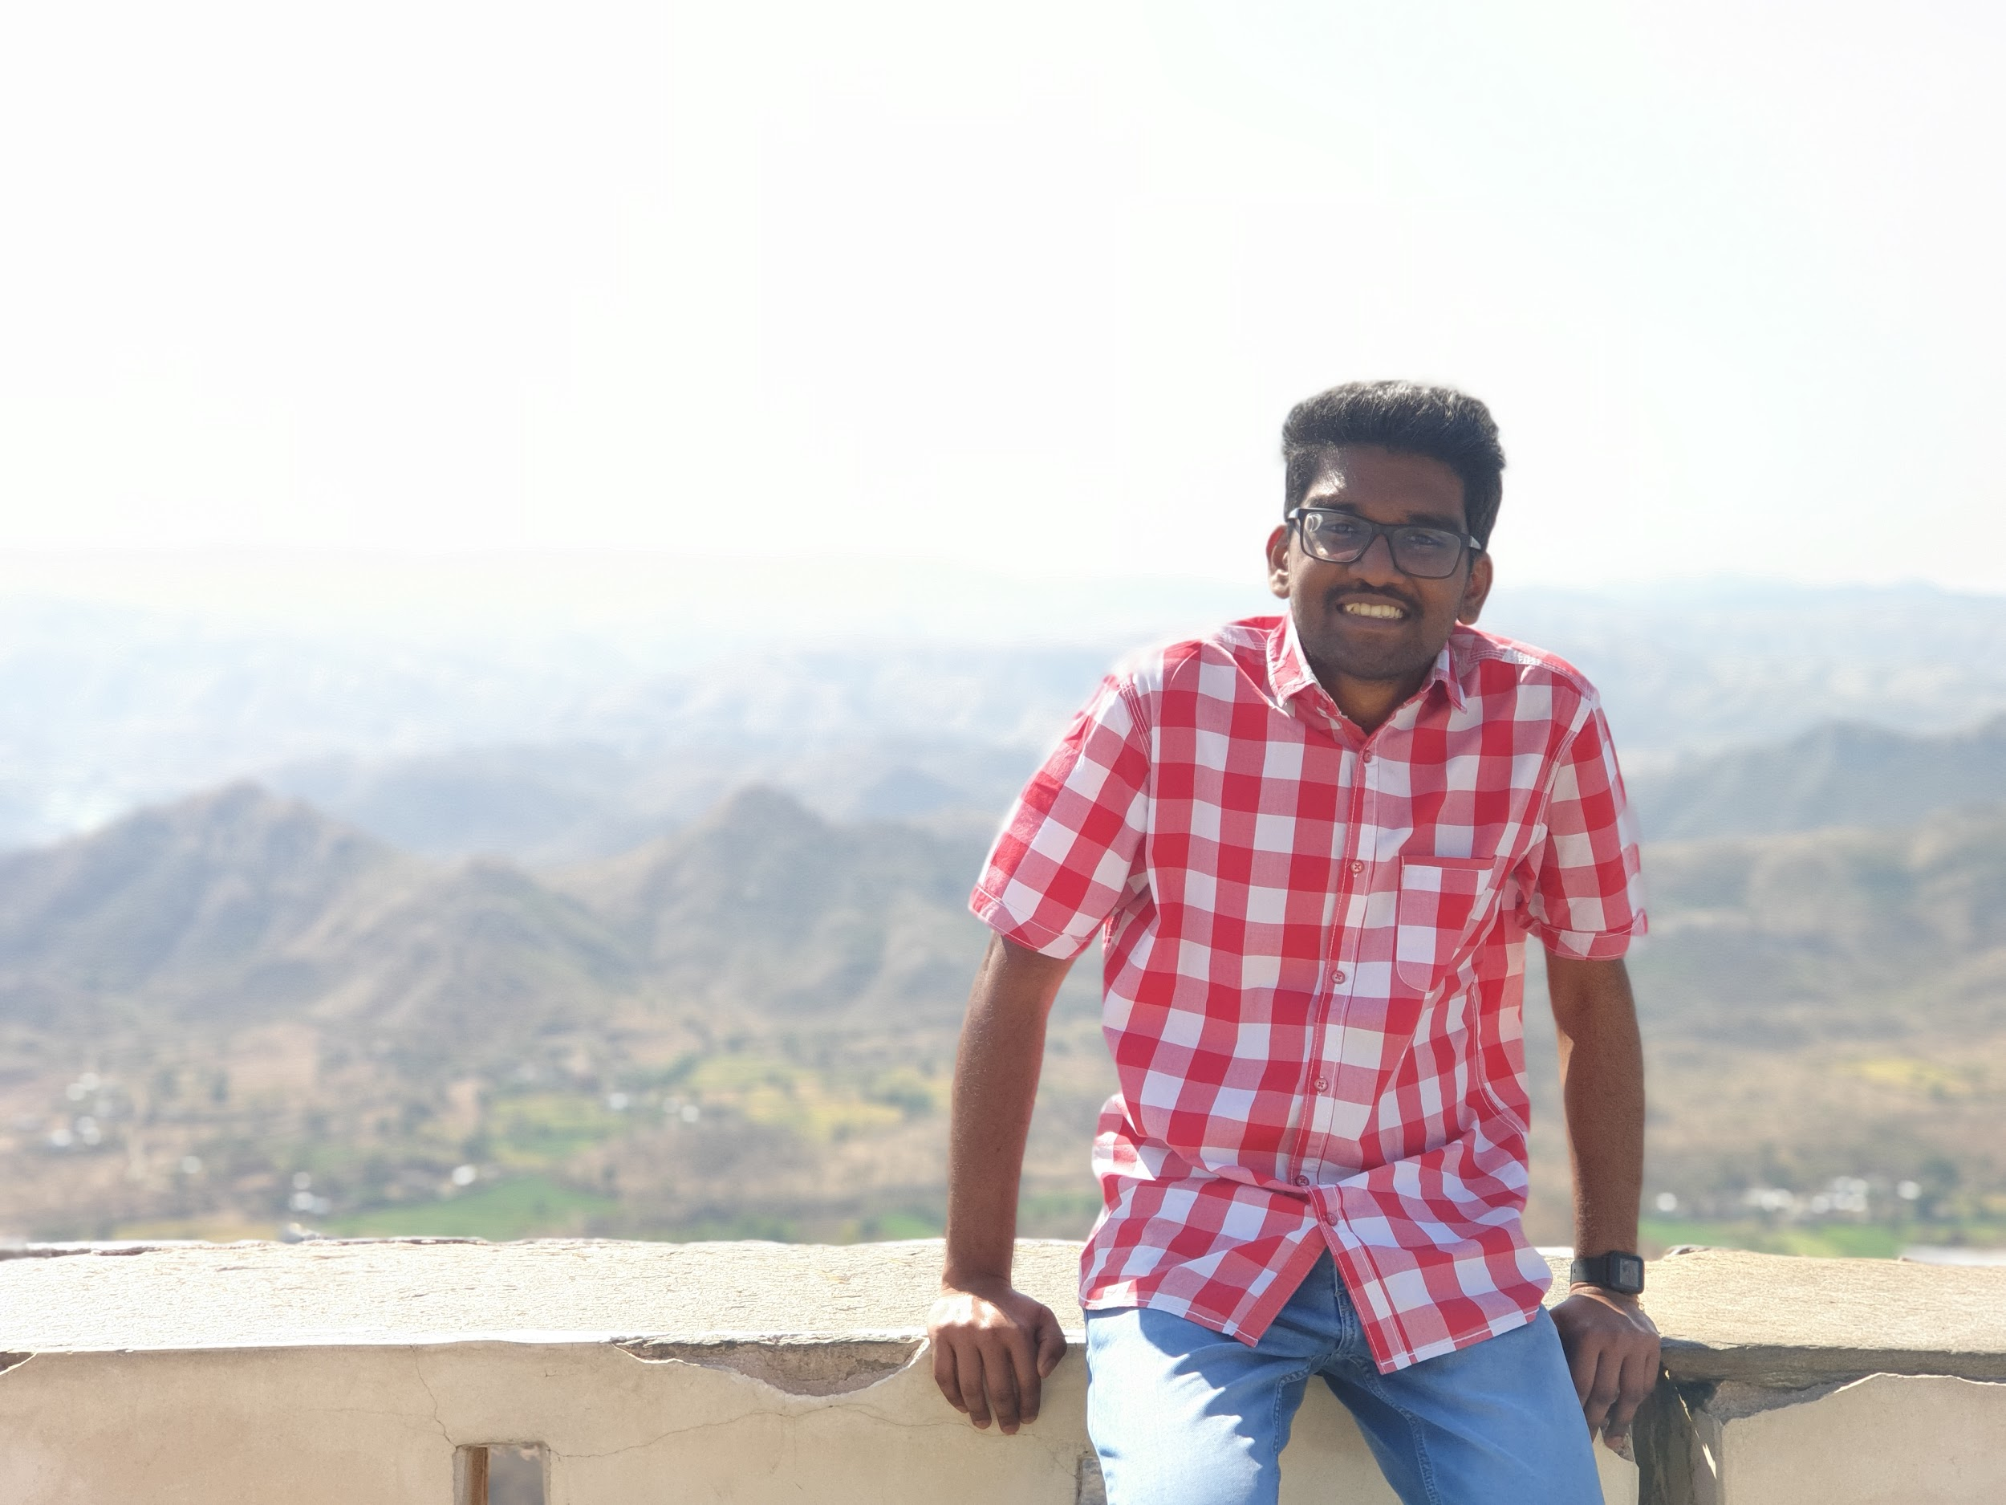

Team Members
Priyanshu Joshi
Anurag Porel
Chirag Chawla
Karunesh Bamanjogi
G Shalom
Divyanshi Yadav

Slide 3
Idea Summary
Shift workers often don’t find an easy way to balance their sleep with the various activities they need to do. They often remain drowsy and cannot work properly.
Our application, which is a Sleep Shift Scheduling Tool, aims to solve this major issue. The user would have to enter their shift timings and our specialized algorithm will suggest sleeping slots and the number of sleeping cycles.
This will help the user’s body to rest properly and will help them balance their busy schedules. Also, depending on the user’s entered activity status and program, the daily calorie requirement and customized carbohydrate, protein and fat will be shown.

Slide 4
Sleep Shift Scheduling Tool
We have developed a desktop application which works as a sleep scheduling tool and a diet planning tool which suggests required nutritional requirements.
The application is designed to take certain inputs from the user and then it accordingly suggests the amount of sleep and nutrition required by the user. It is very efficient in terms of time and efforts.
It works according to the sleep scheduling algorithm, the user can choose their preferred time to sleep and accordingly the application manages your sleep schedule. It also provides the information of the user’s required nutrition intake, which is conveniently stored in a PDF for future reference.

Slide 5
Tools And Technologies Used
Python as language
Tkinter Module for GUI
Python datetime module to schedule the sleep shifts
fpdf module to save the report in pdf format
pyinstaller to make the .exe file from .py file

Slide 6
How We Used Space Data ?
We ingest the Global Imagery Browse Services (GIBS) APIs from NASA and combine it with other Health statistics and other external services, to provide users accurate information via a user-friendly interface.
Using this application the user can put in their prefered time to sleep ,which is completely flexible.
Our application works on the NASA Space Agency data provided to us. We referred to the time slots in the sleep timing details provided to us in the database and also the data for nutrition values was used. The information was the major resource and influenced our project to be more effective.
They will have the liberty to choose any time slot they want ,the algorithm will work with reference to it and the application will display the sleep schedule. The user will have practice so that their body clock adjusts itself according to that time and they'll fall asleep at that particular time.

Slide 7
THANK YOU

